Slide 1
Three Days Workshop On Machine Learning [Day 3]
Organized By:
Association of Computer Engineering Students (ACES)
Eastern Region Campus (ERC), Dharan, Nepal
Instructor:
Manish Bhurtel
AI Engineer at ASMI Corp

Slide 2
REINFORCEMENT LEARNING (RL)

Slide 3
Reinforcement Learning (RL)
WHAT IS Rl?
RL is the novel” machine’s self-learning” approach in which an agent learns by itself following some criteria.
RL is developed by Prof. Dr. Richard Shutton
A Canadian Computer Scientist
Research Scientist at Google DeepMind
Professor at University of Alberta, Canada

Slide 4
Reinforcement Learning (RL)
WHY Rl?
Has the ability to learn by interacting with environment.
More human like learning.
Best suited when we have no dataset about a scenario.
Analogy: The way human child learns to walk by trial and error.
Child falls several time and again tries to walk.
Eventually, the child learns to walk.

Slide 5
Reinforcement Learning (RL)
Three ELEMENTS of basic rl:
Agent: Takes actions or moves to change states.
Environment: Entity in which the agent takes actions.
Reward: Feedback returned by the environment.
From the previous child analogy:
Agent: Child
Environment: Physical space in which child tries to walk ( A room)
Reward: Gets injured if falls or is praised if can walk.

Slide 6
Reinforcement Learning (RL)
Environment
Action
Agent
Reward
Next state

Slide 7
Reinforcement Learning (RL)
The goal in RL is to maximize the reward it gets from environment.
Sequence of actions that gave the higher reward is the optimal move.

Slide 8
Reinforcement Learning (RL)
Exploration- Exploitation Tradeoff
You go to a new restaurant
Day 1: Try dish 1 ( If tasty, Reward = Good)
Day 2: Try dish 2 ( If not tasty, Reward = Bad)
Next time you visit and always order dish 1.
Exploitation
What if there are multiple other dishes which could taste much better than dish 1?
You try every dishes and finally know the best food in that restaurant. On doing this initially you will spend money on “some not good foods” but eventually you will know the “tasty food”.
Note: RL agent sacrifice immediate reward for long-term collective reward.
Exploration
Strategy: Epsilon-greedy (Explore for some time and exploit the best results)

Slide 9
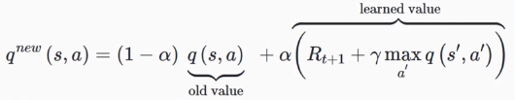
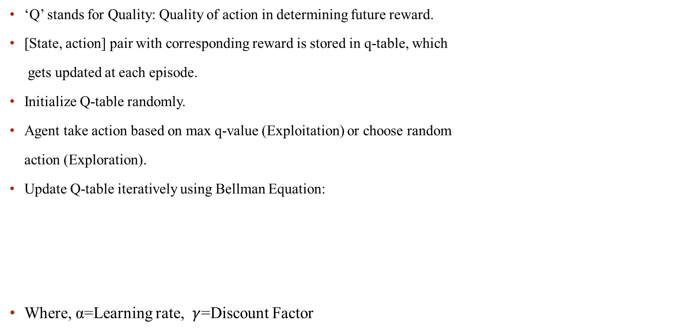
Reinforcement Learning (RL)
Q-learning Algorithm
‘Q’ stands for Quality: Quality of action in determining future reward.
[State, action] pair with corresponding reward is stored in q-table, which
gets updated at each episode.
Initialize Q-table randomly.
Agent take action based on max q-value (Exploitation) or choose random
action (Exploration).
Update Q-table iteratively using Bellman Equation:
Where, α=Learning rate, $γ$=Discount Factor

Slide 10
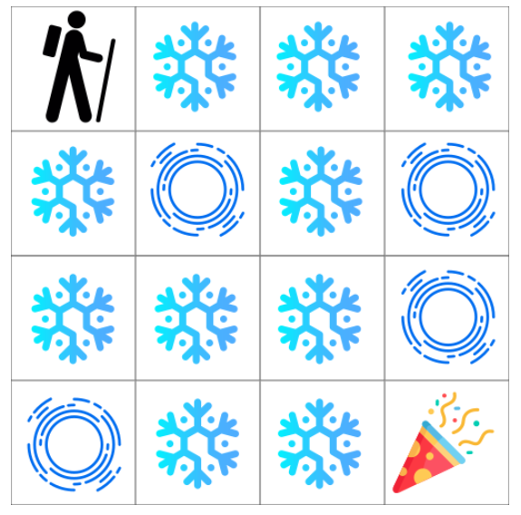
Frozen Lake Example
Reinforcement Learning (RL)
There is a lake with frozen ice.
But there are also some melted ice, called hole.
Now we need to use the Reinforcement Learning (Q Learning) where the agent learns to reach the goal with maximum rewards.
The grid of the Frozen Lake is as follows:
SFFF S = Start Point (Safe)
FHFH F = Frozen Lake (Safe)
FFFH H = Hole (Unsafe)
HFFG G = Goal
An episode ends if the agent reaches the goal or falls in a hole.
It receives the reward of 1 if it reaches the goal and 0 otherwise
Action Space: Left, Right, Up, Down
State Space: 16 states

Slide 11
Applications of RL
Reinforcement Learning (RL)
RL in Self Driving Cars (AWS Deep Racer)
RL in self solving games (Pacman, Rubik’s Cube, Tic Tac Toe, 2048, etc)
RL in recommendation systems
Robotics Manipulation
Drug Discovery (RL + GAN)

Slide 12
Reinforcement Learning (RL)
Do You Know ALPHA GO?
AlphaGo is a computer program that plays the board game Go. It was developed by DeepMind Technologies which was later acquired by Google.
Alpha Go won against 18 times world champion Lee Sedol.
Alpha Go won 4/5 games in the total set.
Yes this works with the combination of Deep Neural Networks and Reinforcement Learning

Slide 13
GENERATIVE ADVERSARIAL NETWORK (GAN)

Slide 14
GENERATIVE ADVERSARIAL NETWORK (GAN)
GANs are the deep neural networks that work together in an adversarial way.
The words represent:
Generative: The model generates new data which belongs to the input data distribution.
Adversarial: The two neural networks compete against each other.
Proposed By: Ian Goodfellow in 2014
Director of Machine Learning in Special Projects (Apple Inc)
Former research scientist at Google Brain
BS and MS @ Stanford University under supervision of Prof. Dr. Andrew NG
PhD @ University of Montreal under the supervision of Prof. Dr. Yoshua Bengio

Slide 15
GENERATIVE ADVERSARIAL NETWORK (GAN)
GANs consists of two different neural networks. They are:
Discriminator: This model receives the data from the actual data distribution ‘AD’ and the fake data from the Generator model ‘FD’. Then it classifies the input data into 2 classes: “Actual Data” (class: 1) – those from actual dataset and “Fake Data (class: 0) – those generated from Generator”.
Generator: This model receives a noise data from a random distribution ‘Z’ and using the noise data generates a new data belonging to a distribution ‘FD’ which is as close to actual data distribution ‘AD’. Then output of the Generator passed into the Discriminator.
So basically, GAN is running of the Min-Max algorithm between Generator and Discriminator

Slide 16


LOSS FUNCTION
Discriminator Loss:
mean(log(real_output_Disc) + log(1 – fake_output_Disc))
Generator Loss:
mean(log(1 – D(fake_output_Disc))

Slide 17
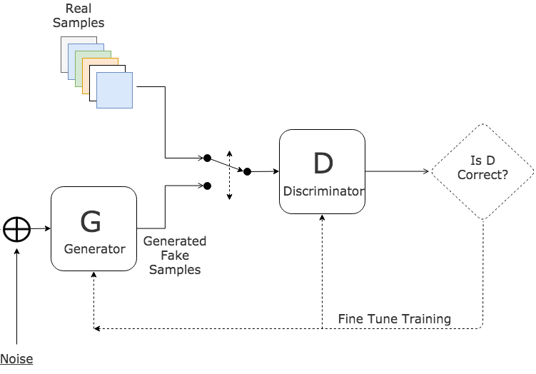
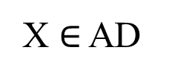

GENERATIVE ADVERSARIAL NETWORKS (GAN)
Actual Distribution (AD)
Fake Distribution (FD)
FD ~ AD
X $∈$ AD
D(X)
D(G(Z))
G(Z) $∈$ FD
Z

Slide 18
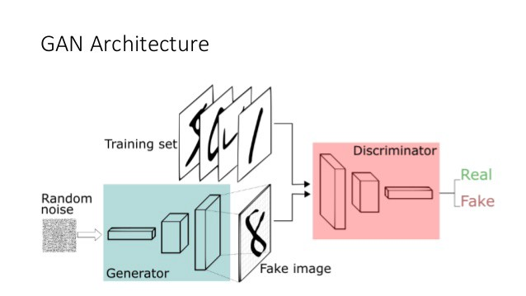
GENERATIVE ADVERSARIAL NETWORKS (GAN)

Slide 19




GENERATIVE ADVERSARIAL NETWORKS (GAN)
DISCRIMINATOR NETWORK
INPUT LAYER
HIDDEN LAYER
OUTPUT LAYER
784 * 256
$$Σ$$
f
256 * 1
X₁
Sigmoid
X₂
$$Σ$$
f
784
.
.
256
.
.
1 => Real
0 => Fake
.
.
.
$$Σ$$
f
X₃
.
.
.
X_{n}
$$Σ$$
f

Slide 20







GENERATIVE ADVERSARIAL NETWORKS (GAN)
GENERATOR NETWORK
INPUT LAYER
HIDDEN LAYER
OUTPUT LAYER
100 * 256
256 * 784
$$Σ$$
f
X₁
$$Σ$$
f
$$Σ$$
f
X₂
100
$$Σ$$
f
784
.
.
256
.
.
$$Σ$$
f
X₃
.
.
784
.
.
.
.
.
.
.
.
.
.
.
X_{n}
$$Σ$$
f
$$Σ$$
f

Slide 21
ALGORITHM
GENERATIVE ADVERSARIAL NETWORKS (GAN)
1. Import the packages
2. Get the dataset
3. Set the parameters and size of the images
4. Initialize the weights/ biases at the hidden and final layer for discriminator and generator (Xavier Initialization)
5. Define the Discriminator and Generator models
6. Define the placeholder which can hold the input image and noise data.
7. Now build the Generator network: It takes the noise data and returns the data of the shape of actual input image.
8.1 Build the Discriminator network with the actual data
8.2 Build the Discriminator network with the fake data from the generator
9. Initialize the optimizer to minimize the loss of Discriminator and Generator
Intuition: Generator aim to increase the loss of the Discriminator by producing better results.
10. Train the generator and discriminator alternatively.
11. Try to generate new data.

Slide 22
APPLICATIONS OF GAN
GENERATIVE ADVERSARIAL NETWORKS (GAN)
Deep Fakes
GAN in Movies?
3D GAN (pdf)? In Amazon?
Music Generation (pdf)

Slide 23
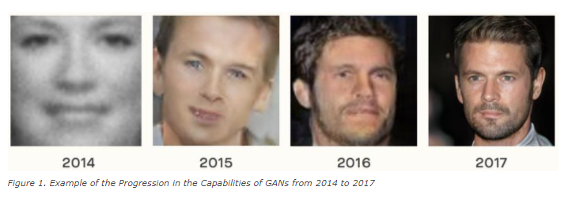
GENERATIVE ADVERSARIAL NETWORKS (GAN)
Progress in GAN

